Slide 1



East Coast vLLM Meetup
2025-03-11

Slide 2
Welcome!
5:00 - 6:00
6:00 - 6:30
6:30 - 6:50
6:50 - 7:10
7:10 - 7:15
7:15 - 7:45
7:45 - 9:00
Meet & Greet
vLLM Update
Model Optimization in vLLM
Hardware Update (Redacted)
Join the Open Source AI Movement!
Q&A
Social Hour & Networking

Slide 3
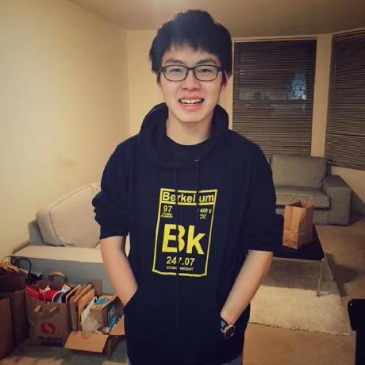
vLLM Update
Simon Mo
PhD Student, UC Berkeley
vLLM Maintainer

Slide 4
vLLM's Goal
Build the fastest and
easiest-to-use open-source
LLM inference & serving engine

Slide 5



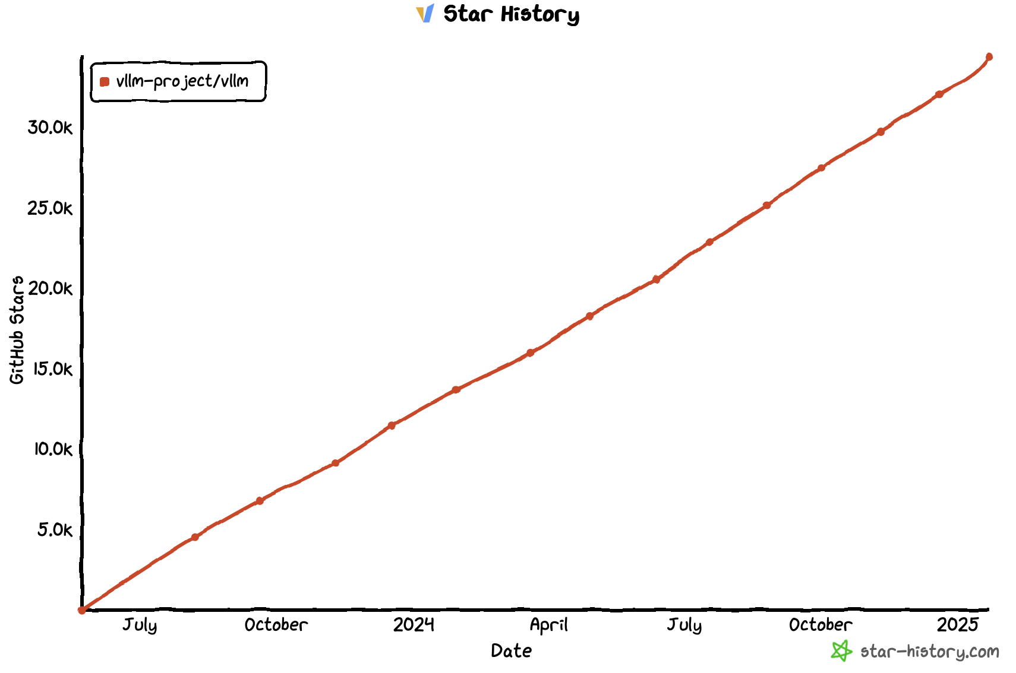
vLLM Today
https://github.com/vllm-project/vllm
$ pip install vllm
41K Stars
Official
release!

Slide 6
vLLM API (1): LLM class
A Python interface for offline batched inference
from vllm import LLM
# Example prompts.
prompts = ["Hello, my name is", "The capital of France is"]
# Create an LLM with HF model name.
llm = LLM(model="meta-llama/Meta-Llama-3.1-8B")
# Generate texts from the prompts.
outputs = llm.generate(prompts) # also llm.chat(messages)]

Slide 7
vLLM API (2): OpenAI-compatible server
A FastAPI-based server for online serving
Server
$ vllm serve meta-llama/Meta-Llama-3.1-8B
Client
$ curl http://localhost:8000/v1/completions \
-H "Content-Type: application/json" \
-d '{
"model": "meta-llama/Meta-Llama-3.1-8B",
"prompt": "San Francisco is a",
"max_tokens": 7,
"temperature": 0
}'

Slide 8
Q1 Update Agenda
vLLM V1
DeepSeek Enhancements
Q1 Roadmap Update
Ecosystem Projects

Slide 9
vLLM V1

Slide 10
What is vLLM V1?
Re-architect the “core” of vLLM
based on the lessons from V0 (current version)
Unchanged
Changed
User-level APIs
Models
GPU Kernels
Utility functions
...
Scheduler
Memory Manager
Model Runner
API Server
...

Slide 11
Why vLLM V1?
Main goals:
Simple & easy-to-hack codebase
vllm/v1/core/scheduler.py 608 LOC (>2k LOC in v0)
High performance with near-zero CPU overheads
Combining all key optimizations & enabling them by default

Slide 12
Key changes in vLLM V1
Optimized engine loop & API server
Simplified scheduler
Clean implementation of distributed inference
Piecewise CUDA graphs

Slide 13
Key changes in vLLM V1
Optimized engine loop & API server
Simplified scheduler
Clean implementation of distributed inference
Piecewise CUDA graphs

Slide 14
Simplified Scheduler
Synchronous single-step scheduler
Chunked prefills (aka Dynamic SplitFuse) by default
The scheduling decision is simply represented as a dictionary of {request_id: num_tokens}
R1
R2
Prompts
R3
Token budget (10)
Scheduler Output
{request: num_tokens}
Step 0
{R1: 3, R2: 5, R3: 2}
Step 1
{R1: 1, R2: 1, R3: 8}
Step 2
{R1: 1, R2: 1, R3: 2}
Step 3
{R1: 1, R2: 1, R3: 1}

Slide 15
Simplified Scheduler (cont’d)
Unification of “prefill” and “decode”
In V1, there’s no concept of prefill and decode
Schedule based on the difference between num_compute_tokens and len(all_token_ids)
Ex1) “Prefill” & “Decode”
num_computed_tokens: 0
all_token_ids
AI | is | the | future | of
Schedule 5 tokens (“prefill”)
num_computed_tokens: 5
AI | is | the | future | of
tech
all_token_ids
Schedule 1 token (“decode”)

Slide 16
Simplified Scheduler (cont’d)
Unification of “prefill” and “decode”
In V1, there’s no concept of prefill and decode
Schedule based on the difference between num_compute_tokens and len(all_token_ids)
Ex2) Chunked prefills
num_computed_tokens: 0
all_token_ids
AI | is | the | future | of
Schedule 3 tokens out of 5
num_computed_tokens: 3
AI | is | the | future | of
all_token_ids
Schedule 2 tokens

Slide 17
Simplified Scheduler (cont’d)
Unification of “prefill” and “decode”
In V1, there’s no concept of prefill and decode
Schedule based on the difference between num_compute_tokens and len(all_token_ids)
Ex3) Prefix caching
num_computed_tokens: 2
all_token_ids
AI | is | the | future | of
Cache hit!
Schedule 3 tokens

Slide 18
Simplified Scheduler: Next Steps
Current: First-come-first-served policy is baked in the scheduler
Next step 1: Support various scheduling policies
Priority-based scheduling
Fair scheduling
Predictive scheduling
Next step 2: Pluggable scheduler
E.g., workload-specific scheduler
E.g., different schedulers for different hardware backends

Slide 19
Piecewise CUDA Graphs
Q
K
V
V0: Single CUDA graph for the entire model
Pros: Minimal CPU overheads in model execution
Cons: Limited flexibility
Static shapes are required
No CPU operations are allowed
→ Increased development burden
MLP 1
MLP 0
O
Attention
Q
K
V

Slide 20
Piecewise CUDA Graphs (cont’d)
Q
K
V
MLP 1
CUDA graph N
MLP 0
Graph split using torch.compile
O
Attention
PyTorch Eager
Q
K
V
CUDA graph N-1

Slide 21
Piecewise CUDA Graphs (cont’d)
Q
K
V
V1: Splits the model into pieces
Runs the attention op in eager-mode PyTorch
Runs other ops with CUDA graphs
Easy to capture, since the ops are token-wise
Critical to capture the all-reduce op
Pros: Maximum freedom in implementing the attention op
No restriction on shapes
Any CPU operations are allowed
Cons: CPU overheads unhidden by CUDA graphs could slow down the model execution
Negligible for 8B+ models on H100
MLP 1
MLP 0
O
Attention
Q
K
V

Slide 22
Potential Use Cases of Piecewise CUDA Graphs
Piecewise CUDA graphs will allow vLLM to easily integrate new optimizations such as:
Cascade Attention
KV cache offloading to CPU memory (#11532)
KV cache offloading to disk
Sparse KV cache
Brand-new attention algorithms
. . .

Slide 23
V1 Current Status
Set VLLM_USE_V1=1 to use the V1 engine
Same end-user APIs as V0 (OpenAI server & LLM class)
On by default for supported use cases in the upcoming v0.8.0 release.
Supported models
Decoder-only Transformers (e.g., Llama, Mixtral)
Llava-style LMMs (e.g., Qwen2.5-VL, Pixtral)
Features
Supported: chunked prefills, prefix caching, tensor parallelism, LoRA, spec decoding (n-gram only for now), pipeline parallelism, structured outputs
Only supports NVIDIA GPUs for now
AMD, TPU, HPU work in progress

Slide 24

DeepSeek Support

Slide 25
State of DeepSeek Model Support
4 Major Performance Levers:
MLA: Multi-head Latent Attention (✅ v0, ✅ v1)
MTP: Multi-Token Prediction (✅ v0, ⌛v1)
EP: Expert Parallelism (✅v0, ✅ v1)
DP: Attention Data Parallelism (❎v0, ✅ v1)
vLLM’s unique features:
Pipeline Parallelism
Integration with SOTA kernels (FlashMLA, FlashInfer, FlashAttention)
More spec decode methods (ngrams, draft based, etc)
Ecosystem of RLHF integrations, offline inference & serving infra

Slide 26
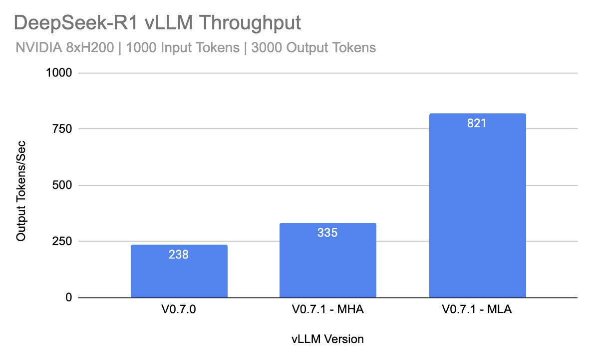
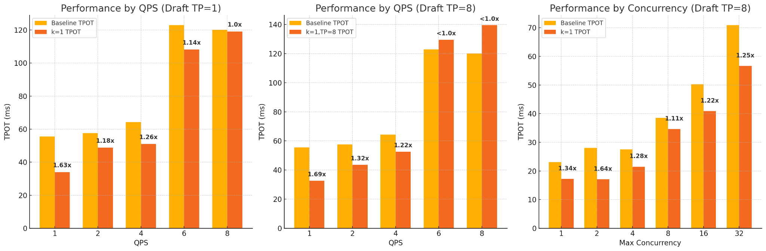
V0 Results of MLA and MTP
Multi-head Latent Attention: 2.4x decoding throughput against MHA
Multi-token prediction (k=1): Improve TPOT with low QPS

Slide 27
Q1 Roadmap

Slide 28
vLLM Core
⌛Ship a performant and modular V1 architecture
🏎️ V1 on by default
✅ Spec decode
⌛Hybrid memory allocator
🏗️Documentation and Design Docs
Support large and long context models
✅ Sparsity in attention and MoEs
🏎️ Disaggregated prefill support
Improved performance in batch mode
✅ RLHF
⌛ Long Generation

Slide 29
Features
Model Support
✅ Arbitrary HF model
⌛Alternative checkpoint format
Hardware Support
🏎️Blackwell
⌛Improved Tranium/Inferentia, Gaudi
🏎️Productionize and support large scale deployment of vLLM on TPU
✅ Out of tree support for IBM Spyre and Ascend
Optimizations
⌛ AsyncTP/Flux
✅ FlashAttention3
Usability
⌛Multi-platform wheels and distributions

Slide 30
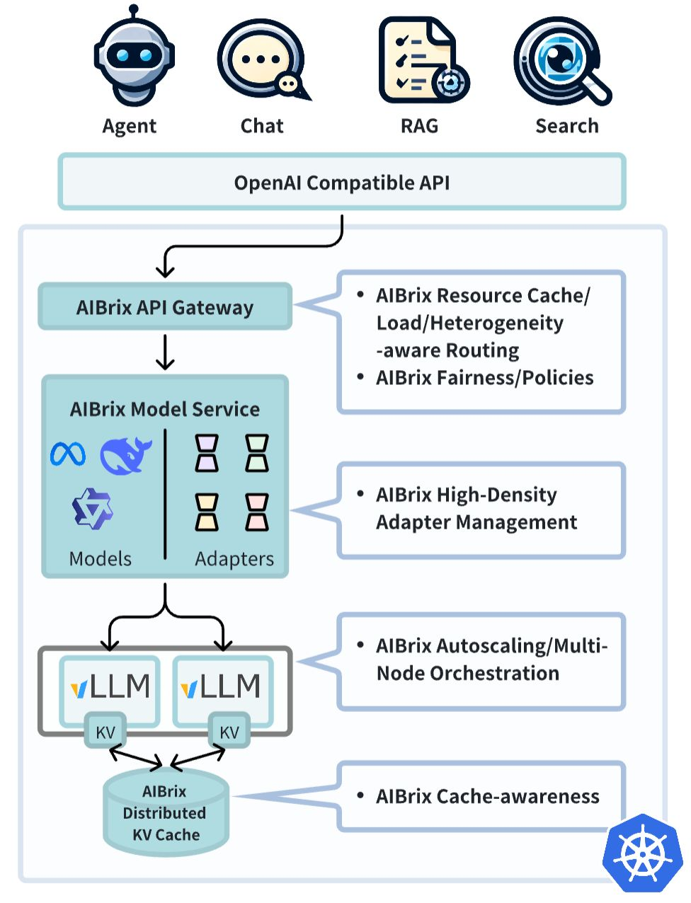
Ecosystem Projects
Welcome AIBrix!
🤔 Distributed batch inference
✅ Large scale serving
✅ Prefix aware router
🤔 Multi-modality output

Slide 31























Thank you sponsors (funding compute!)

Slide 32
Our Goal
Build the fastest and
easiest-to-use open-source
LLM inference & serving engine

Slide 33






Building the fastest and easiest-to-use open-source LLM inference & serving engine!
https://github.com/vllm-project/vllm
https://twitter.com/vllm_project
https://slack.vllm.ai
https://opencollective.com/vllm
https://www.linkedin.com/company/vllm-project

Slide 34
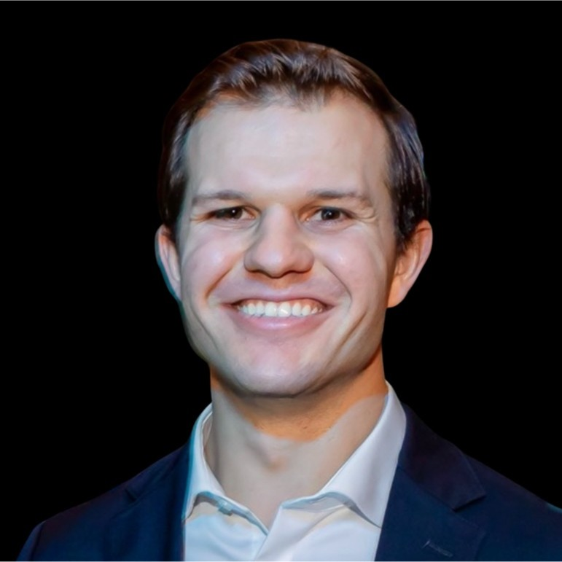
Model Optimization in vLLM
Robert Shaw
Director of Engineering, Red Hat
vLLM Committer

Slide 35
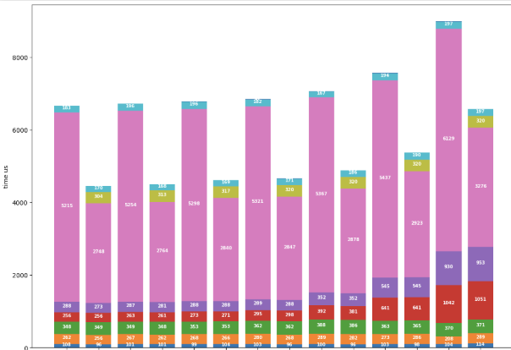
Why Optimize Your Model?
Reduce GPU RAM requirements
Parameters are most of the RAM usage for reasonable sequence lengths
Accelerate linear layers
Reduce data movement
Leverage low precision tensor cores
Negligible impact on model quality with fine-grained quantization
Breakdown of performance of individual decode iterations for Llama-3-8B FP16 and FP8. The x-axis sweeps over batch size 1 to 128. Pink regions are the linear layers

Slide 36
Quantization Support in vLLM
Our goal with vLLM
vLLM quantization design
Build the fastest and easiest-to-use open-source LLM inference & serving engine
Fast inference kernels for serving
Ecosystem compatibility
Pre-quantized model repository
Unified llm-compressor framework for creating quantized models

Slide 37
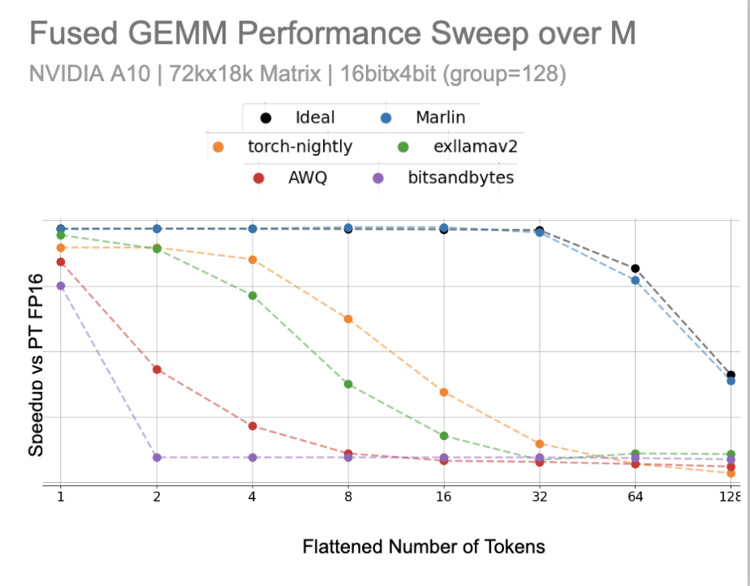
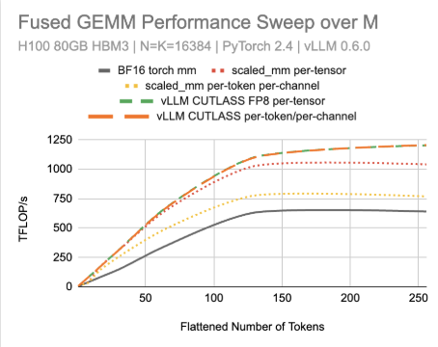
Kernels
We write custom CUTLASS and Triton kernels for quantized compute
MARLIN kernel in vLLM targets the inference serving regime
FP8 W8A8 in vLLM is faster than baseline PyTorch implementation

Slide 38
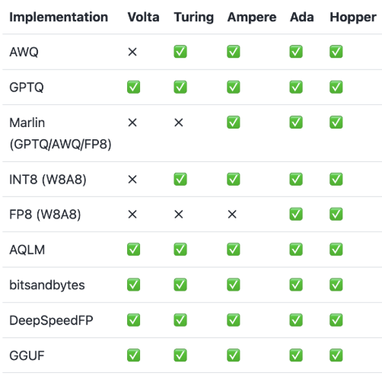

Ecosystem Compatible
We work hard to make sure key quantization formats run on vLLM
Various quantization formats (AutoAWQ, AutoGPTQ, GGUF) used by the OSS ecosystem
Most popular formats are integrated in vLLM can be natively loaded and run with our most optimized kernels
Automatic conversion of AutoGPTQ
and AutoAWQ into MARLIN format

Slide 39




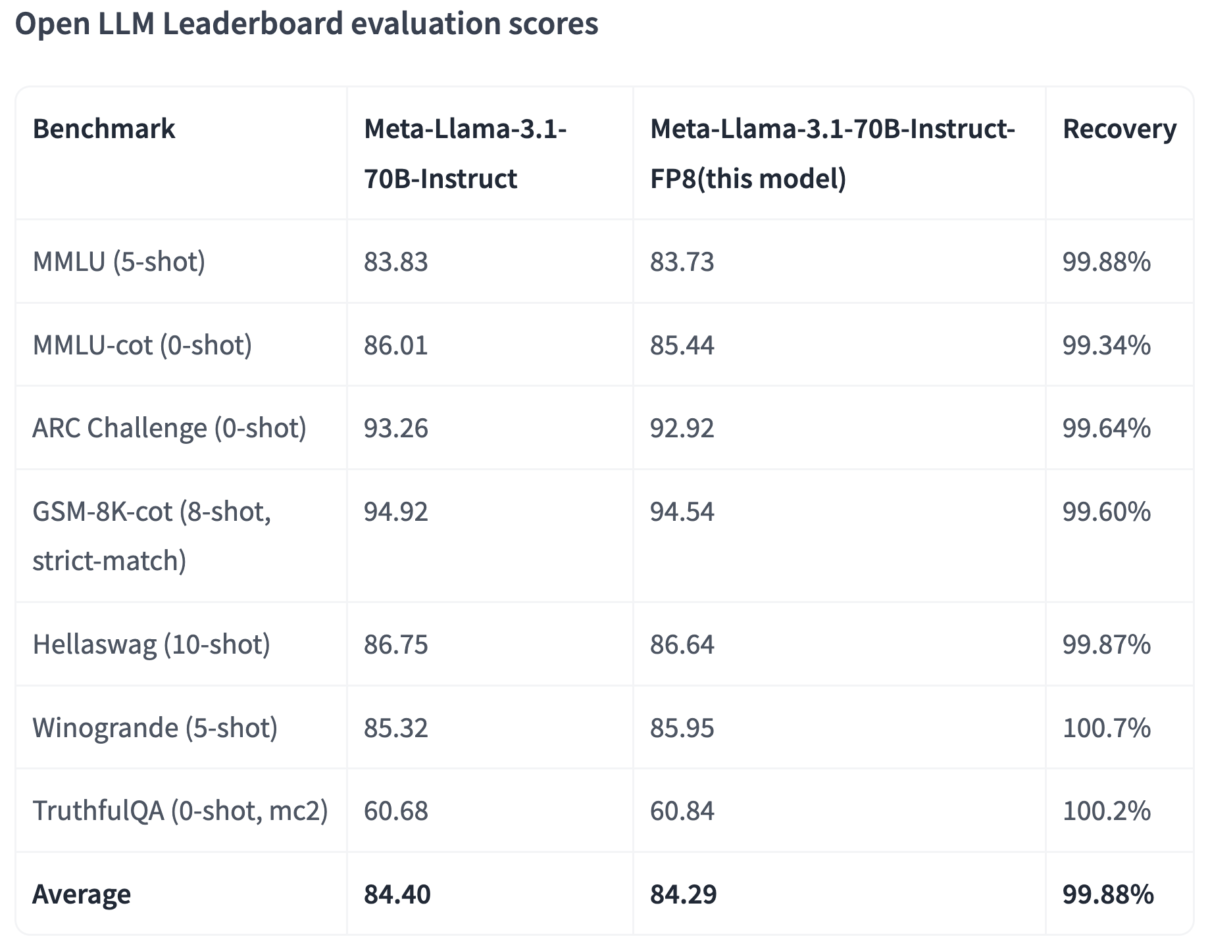







Pre Optimized Models
Maintained, pre-optimized models ready to deploy to production with vLLM
Broad Collection
Comprehensive Validation
Extensive Selection
Formats
W4/8A16
W8A8-INT8
W8A8-FP8
2:4 sparse
Algorithms
GPTQ / AWQ
SmoothQuant
SparseGPT
RTN
Llama
Qwen
Gemma
Hardware
Mistral
DeepSeek
Phi
GPUs
TPUs
Molmo
Granite
Nemotron
Instinct
CPUs

Slide 40

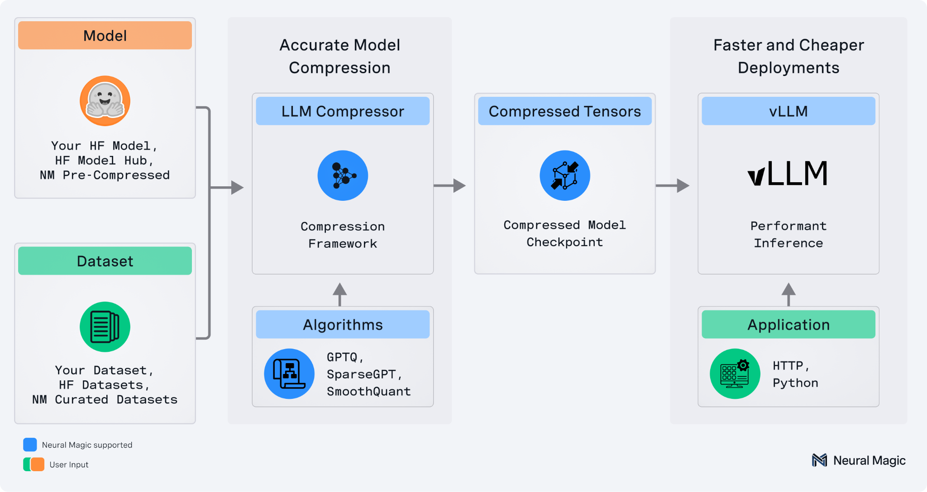
LLM Compressor
Unified framework for creating compressed models
Comprehensive set of algorithms in unified interface
GPTQ, AWQ, SmoothQuant, RTN
FP8, INT8, INT4
Seamless integration w/ HF AutoModel
Safetensors-based checkpoint format compatible with vLLM
Large model support via HF accelerate

Slide 41
The Case For Activation Quantization

Slide 42
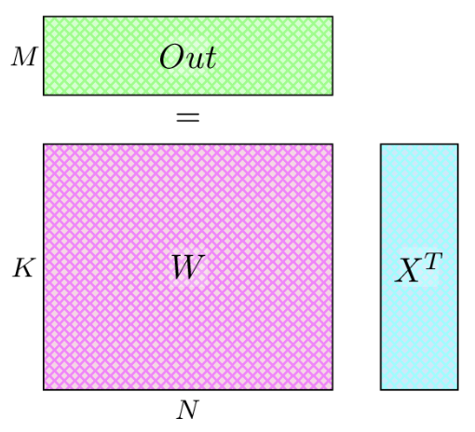
Linear Layers
Linear layers are GEMMs
Large N, K - Llama 3.1 8b sizes:
4096 x 6144 (qkv_proj)
4096 x 4096 (o_proj)
4096 x 28672 (gate_up_proj)
14336 x 4096 (down_proj)
Smaller, variable M
Equal to number of tokens we are processing in a batch
A GEMM computed in a vLLM linear layer.
W is the weight matrix and X is the input activation.
M is the flattened number of tokens being processed.

Slide 43
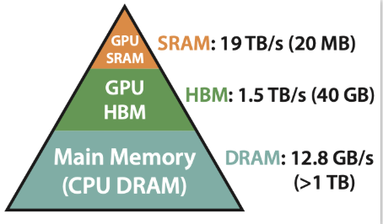
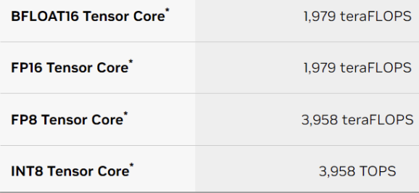
Drivers of GEMM Latency
Latency is driven by (1) bandwidth from HBM → SRAM and (2) tensor core FLOPs
A100 Memory Bandwidth
H100 Tensor Core FLOPS
Quantization reduces data from HBM → SRAM
Quantization can enable more ops per second

Slide 44
Quantization Flavors
We support both weight-only and weight+activation quantization
Weight-Only Quantization
Weight+Activation Quantization
“Just” the weights are quantized
At inference time, “dequantize” the weights and compute with BF/FP16 tensor cores
Reduce data from HBM → SRAM
Both weights and activations are quantized
At inference time, compute with the lower precision cores
Reduce data from HBM → SRAM
Use tensor cores with more FLOPS

Slide 45
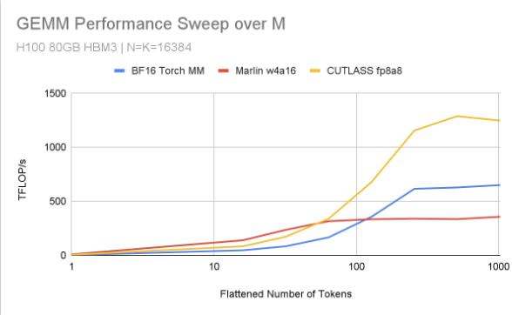
Why Activation Quantization?
Activation quantization accelerates both compute-bound and memory-bound cases
The number of tokens in the batch “M” drives the “arithmetic intensity” of the GEMM
Prefill + high batch decode (Large “M”) are compute-bound
Most time is spent “doing FLOPs”
Low batch decode (Small “M”) are bandwidth-bound
Most time is spend “moving data”
A GEMM computed in a vLLM linear layer.
W is the weight matrix and X is the input activation.
M is the flattened number of tokens being processed.

Slide 46
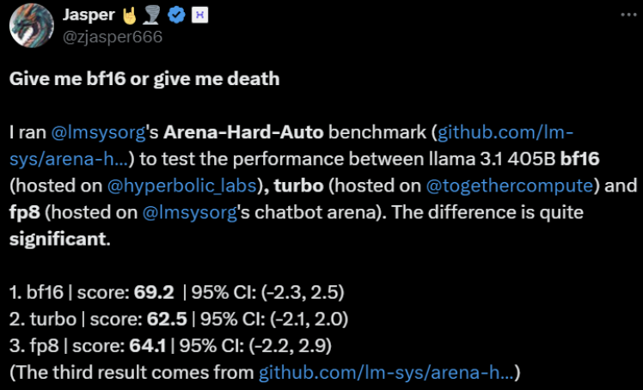
What About Accuracy?

Slide 47
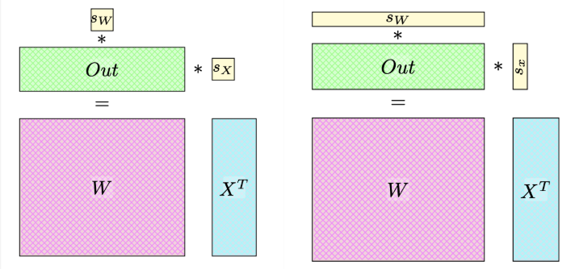



Fine Grained Quantization
Fine-grained quantization enables us to drive significant accuracy
X and W are quantized as:
Rewrite the computation as:
Inside: A quantized GEMM.
Outside: An elementwise multiplication happening during the epilogue.
Scales can be per-tensor: Or per-token/channel:
torch._scaled_mm
Our CUTLASS kernels

Slide 48
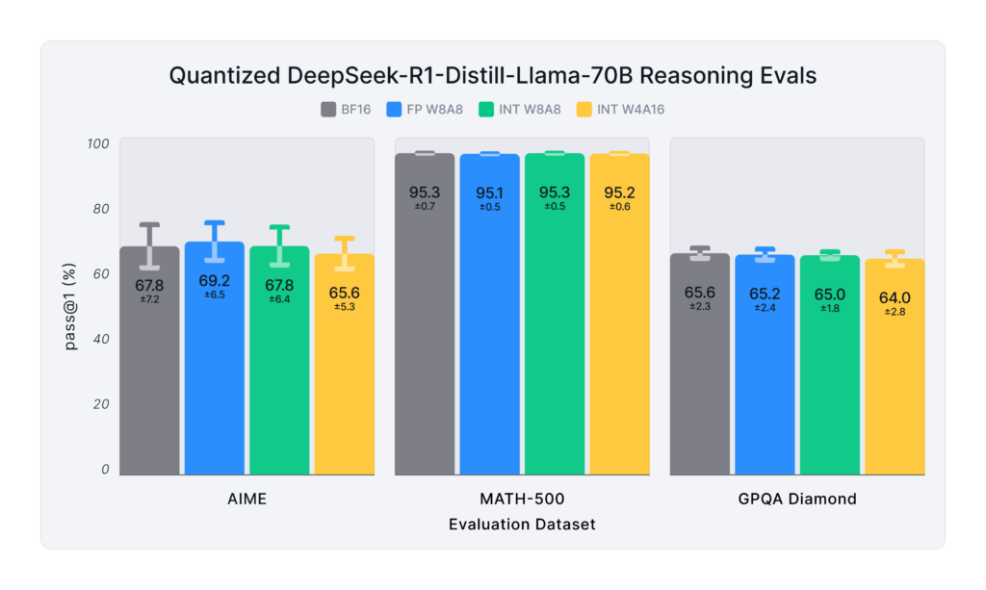
Quantized DeepSeek-R1 Models Deployment-Ready Reasoning Models
Pass@1 score and standard deviation for quantized models on the popular reasoning benchmarks

Slide 49
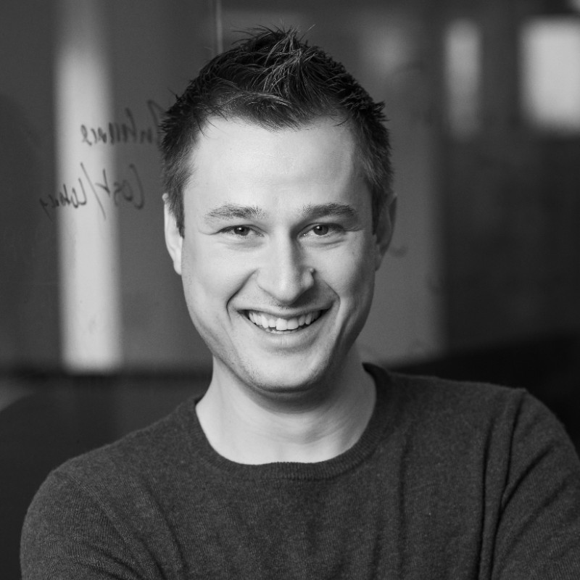
Join the Open Source AI Movement
Saša Zelenović
Principal Product Marketing Manager, Red Hat

Slide 50

Contribute to Key vLLM Features
Comment/review PRs that are interesting to you
Join the discussions on RFCs
Check out “good first issue” tags
Build examples and demos with other tools in the open source AI ecosystem

Slide 51


Join Bi-Weekly vLLM Office Hours
Happening every other Thursday at 2:00PM ET
Hear the bi-weekly vLLM update
Give feedback & ask questions
Deep dive into cutting-edge developments to accelerate your vLLM inference

Slide 52

Let Us Know How We Did Today!
red.ht/4bwOplj
Take 1 minute now to complete our 3-question survey.

Slide 53
Q&A

Slide 54
Thank You!

